Slide 1
BRAND NAME (only chai)
CHUSKI
CHAI ADDA
CHAI JUNCTION
CHUSKI & CHAI
CHAI PE CHARCHA

Slide 2
BRAND NAME (with maskabun)
MASKABAN CHAI HOUSE
MASKABAN CHAI SPOT
MASKABAN CHAI CORNER
MASKABAN CHAI HEAVEN
MASKABAN CHAI CAFE

Slide 3
TAG LINE / SLOGAN
‘‘DOSTON KE SAATH , CHAI KA SWAD’’
‘‘DOSTI KI SHURUAAT , EK CUP CHAI KE SAATH’’
‘‘CHAI AUR DOSTI , PERFECT COMBINATION’’
‘‘CHAI KE BINA , DOSTI ADHURI HAI’’
‘‘DOST HO , TO CHAI HO’’

Slide 4
LOGO
SYMBOL :- GLASS , CUP , KETTLE , ETC...
TYPOGRAPHY :- USE BOLD AND FRIENDLY FONT FOR THE WORD ‘‘CHUSKI’’ .
CONSIDER A HANDWRITTEN OR SLIGHTLY CURVED STYLE AND APPROCHABLE NATURE OF THE BRAND.

Slide 5
LOGO
COLOUR SCHEME :- VIBRANT COLOUR & CHEERFUL COLOUR LIKE ORANGE , YELLOW AND GREEN FOR ENERGY & FRESHNESS...
‘‘COMMONLY ASSOCIATED WITH CHAI..’’

Slide 6
LOGO
OVERALL FEEL :- THE LOGO SHOULD FEEL LIVELY , FUN AND INVITING CAPTURING THE ASSENSE OF ENJOYING A DELIGHTFUL SIP OF CHAI...

Slide 7
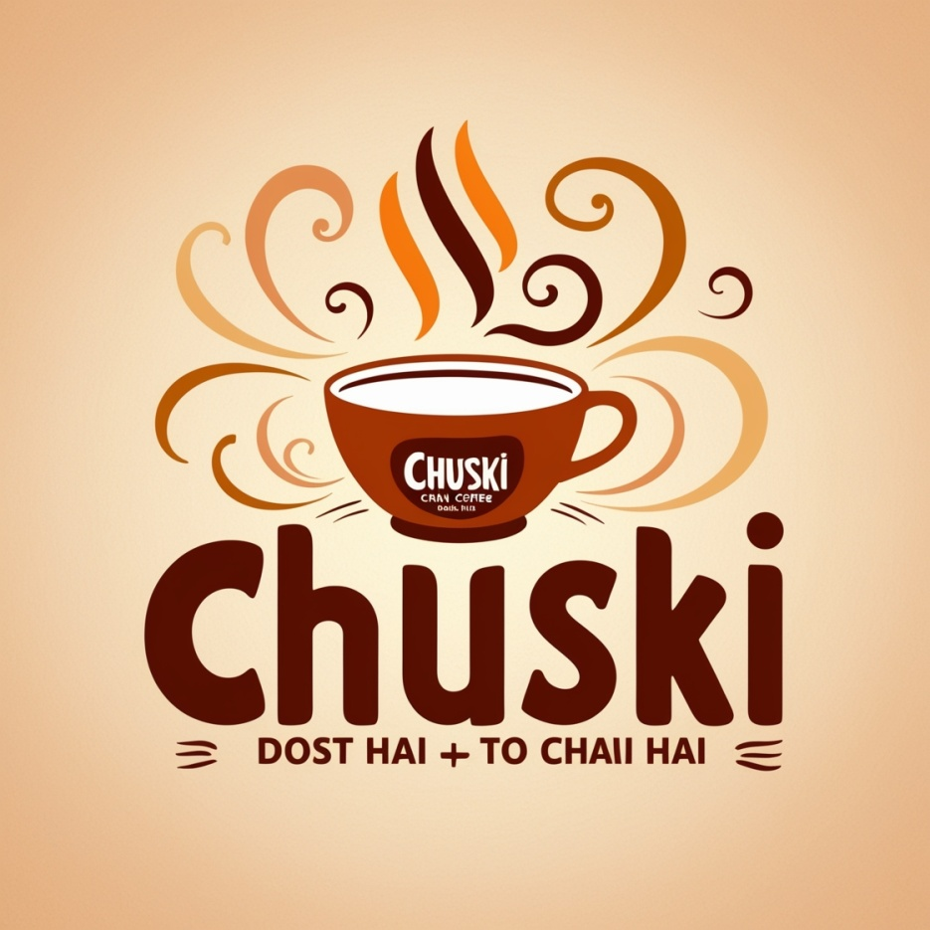
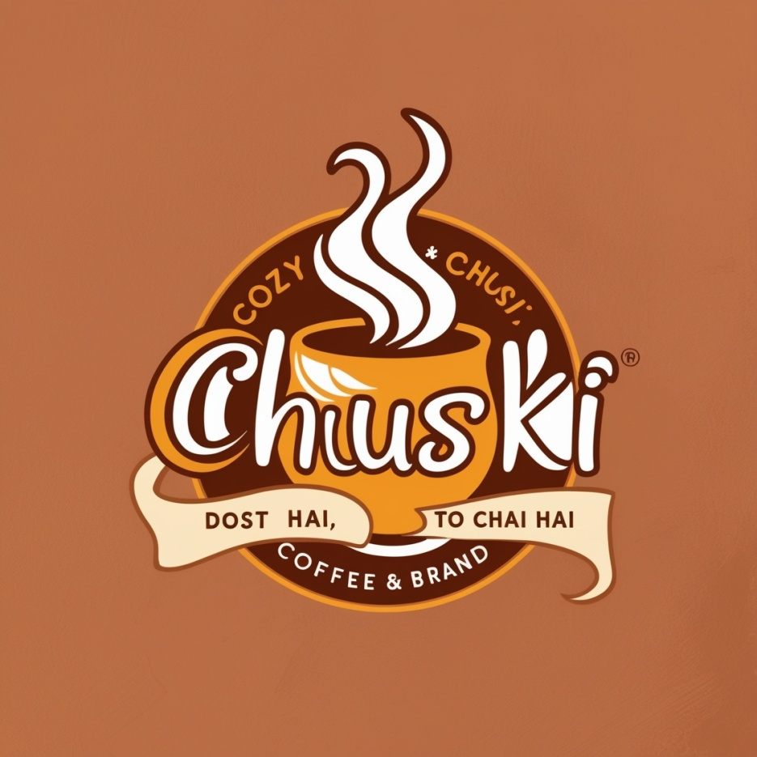
LOGO

Slide 8
OUTLET THEME COLOUR
MAIN COLOUR :- CHOOSE WARM AND INVITING COLOURS SUCH AS DEEP BROWN , EARTHY TONES OR WARM YELLOW . THESE COLOURS EVOKE COZINESS AND COMFORT , REFLECTING THE TRADITIONAL ASPECT OF CHAI.....

Slide 9
OUTLET THEME COLOUR
ACCENT COLOUR :- INCORPORATE VIBRANT ACCENT COLOURS LIKE ORANGE , RED , OR GREEN. THESE COLOURS CAN SYMBOLIZE THE SPICES AND INGREDIENTS USED IN CHAI AND ADD A LIVELY TOUCH TO THE AMBIANCE.

Slide 10
OUTLET THEME COLOUR
BRAND IDENTITY :- USE THE LOGO COLOURS AS A BASE FOR YOUR OVERALL COLOUR SCHEME. ENSURE CONSISTENSY IN COLOUR APPLICATION ACROSS INTERIOR DESIGN ELEMENTS, BRANDING MATERIALS, AND EVEN STAFF UNIFORMS IF APPLICABLE.

Slide 11
OUTLET AMBIANCE
LIGHTING :- SOFT AND AMBIENT LIGHTING THAT CREATES A RELAXED ATMOSPHERE. CONSIDER USING WARM-TONED BULB OR DECORATIVE LANTERNS TO ENHANCE THE COZY FEEL.

Slide 12
OUTLET AMBIANCE
FURNITURE :- CHOOSE COMFORTABLE AND INVITING FURNITURE SUCH AS PLUSH ARMCHAIR, COZY COUCHES, OR WOODEN BENCHES WITH CUSHIONS. MIX TRADITIONAL AND MODERN STYLES TO CREATE A UNIQUE BLEND THAT SUITS THE BRAND’S PERSONALITY.

Slide 13
OUTLET AMBIANCE
DECOR :- DECORATE THE SPACE WITH ELEMENTS THAT REFLECT THE CHAII CULTURE, SUCH AS WALL ART DEPICTING TEA PLANTATION, TRADITIONAL INDIAN PATTERNS, OR FRAMED QUOTES ABOUT TEA. INCORPORATE PLANTS OR GREENERY TO ADD A TOUCH OF FRESHNESS..

Slide 14
OUTLET AMBIANCE
MUSIC :- PLAY SOOTHING BACKGROUND MUSIC THAT COMPLEMENTS THE AMBIANCE, SUCH AS INSTRUMENTAL TRACKS OR SOFT MELODIES. THE MUSIC SHOULD BE SUBTLE ENOUGH NOT TO OVERPOWER CONVERSATION BUT ENHANCE THE OVERALL MOOD.

Slide 15
OUTLET AMBIANCE
SCENT :- INTRODUCE SUBTLE AROMAS OF CHAI SPICES INTO THE AIR, CREATING AN IMMPRESIVE SENSORY EXPERIENCE FOR CUSTOMERS AS SOON AS THEY ENTER THE OUTLET.

Slide 16
INGREDIENTS & RECIPE OF CHAI
INGREDIENTS :-
1 cup water
1/2 cup milk (adjust according to preference)
1 teaspoon black tea leaves (Assam tea works well)
1-2 teaspoons sugar (adjust to taste)
1-2 green cardamom pods, crushed (optional)
A small piece of fresh ginger, crushed (optional)
A pinch of ground cinnamon (optional)
A pinch of ground cloves (optional)

Slide 17
INGREDIENTS & RECIPE OF CHAI
INSTRUCTION :-
Boil Water: In a small saucepan, bring 1 cup of water to a boil.
Add Tea and Spices: Once the water boils, add the black tea leaves and any optional spices (cardamom, ginger, cinnamon, cloves). Stir well.
Simmer: Let it simmer for about 2-3 minutes on medium heat. This helps to infuse the flavors into the water.
Add Milk: Pour in the milk, stirring continuously to blend it with the tea.

Slide 18
INGREDIENTS & RECIPE OF CHAI
Sweeten: Add sugar according to your taste preferences. Stir until the sugar dissolves completely.
Boil Again: Let the chai come to a gentle boil. This helps to integrate all the flavors.
Strain and Serve: Once boiled, strain the chai into a cup using a tea strainer to catch the tea leaves and any spices.
Enjoy: Your ‘‘CHUSKI’’ Chai is ready to be enjoyed hot!

Slide 19
INGREDIENTS & RECIPE OF MASKABUN
INGREDEINTS :-
10 burger buns or pav (Indian dinner rolls)
Butter, softened (as needed)
Green chutney or mint-coriander chutney (optional, for spreading)

Slide 20
INGREDIENTS & RECIPE OF MASKABUN
INSTRUCTIONS :-
Prepare Buns: Slice the burger buns or pav horizontally, keeping them connected on one side (like a hot dog bun).
Butter the Buns: Spread softened butter generously on both sides of the buns.
Optional: If desired, spread green chutney or mint-coriander chutney on the inner sides of the buns for added flavor.
Serve: MaskaBun is ready to be served. It's typically enjoyed hot, often paired with hot tea or coffee.

Slide 21
TYPES OF MASKABUN
1. Butter MaskaBun (Classic):
This is the traditional version where a soft bun is generously slathered with salted butter. It's simple yet delicious and often enjoyed with a hot beverage like tea or coffee.
2. Chocolate MaskaBun:
A modern twist where a bun is filled with chocolate spread or Nutella instead of butter. It's a sweet variation that's popular among those with a sweet tooth.

Slide 22
TYPES OF MASKABUN
3. Cheese MaskaBun:
In this variation, the bun is buttered and filled with slices of cheese. It can be grilled or toasted to melt the cheese, creating a gooey and savory treat.
4. Nutty MaskaBun:
A bun spread with butter and topped with crushed nuts such as almonds, cashews, or pistachios. This adds crunch and nutty flavor to the buttered bun.

Slide 23
TYPES OF MASKABUN
5. Kisan Jaam MaskaBun:
Kisan Jaam Maskabun combines buttered burger buns with Kisan mixed fruit jam, offering a sweet and fruity twist on the classic Indian street snack, perfect for any occasion.
6. Pineapple Jaam MaskaBun:
Pineapple Maskabun features buttered burger buns filled with pineapple jam, offering a sweet and tangy variation on the traditional Indian street food snack, perfect for those who enjoy fruity flavors.

Slide 24
ESTIMATED CAPITAL REQUIRED
STALL RENT :- APPROXIMATELY STALL RENT IN CITY AREA 10000 TO 15000 RUPEES / MONTH.
DEPOSIT :- APPROXIMATELY STALL DEPOSIT 20000 TO 40000 RUPEES.
RAW MATERIAL :-

